Slide 1

VEHICLE PLATE
NUMBER DETECTION & RECOGNITION
By: Srijan Jalal Sec: F Univ Roll No: 2019154 (68) Mentor: Ms. Meenakshi Maindola Presented To: Mr.Priyank Pandey

Slide 2
TABLE OF CONTENTS
01
02
03
04
OBJECTIVE
METHODOLOGY
RESULT AND DISCUSSION
CONCLUSION AND FUTURE WORK

Slide 3
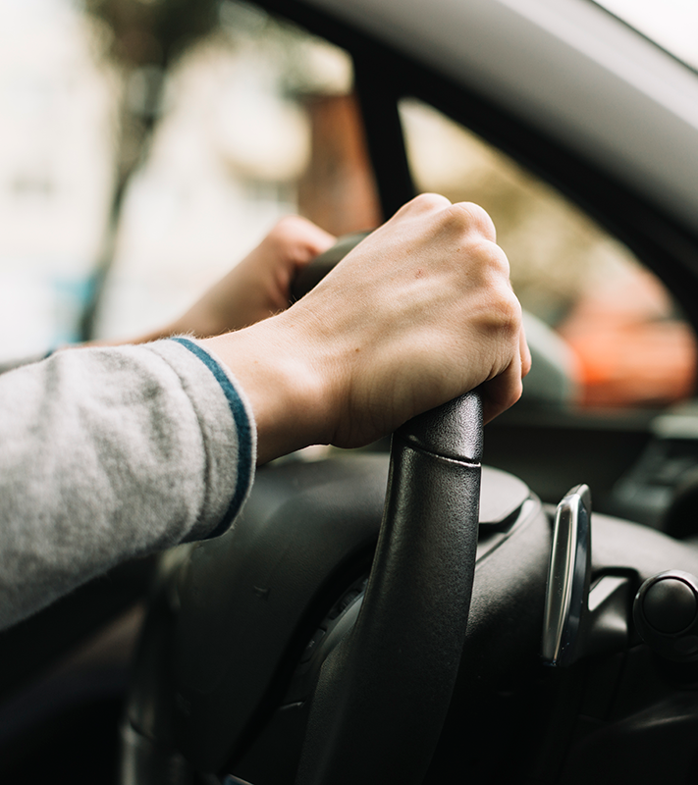
01
OBJECTIVE

Slide 4
1.1 Introduction
My mini-project focuses on the development of a vehicle number plate detection and recognition system using OpenCV in Python. The project aims to utilize image processing techniques to identify number plates in real-time captured from a webcam feed. By employing a Haar cascade classifier, the program detects number plates within the captured frames and subsequently applies optical character recognition (OCR) to extract and interpret the alphanumeric characters from the detected plates. This system intends to showcase a foundational implementation of automated plate identification, potentially applicable in various traffic management, security, or access control scenarios

Slide 5
1.2 Problem Statement
My mini-project in vehicle number plate detection and recognition addresses the challenge of automating plate identification using computer vision techniques. With reference to the provided code utilizing OpenCV and a Haar cascade classifier, the project seeks to tackle real-time detection of vehicle number plates from webcam feeds. The primary objective involves accurately localizing number plates within captured frames and subsequently employing optical character recognition (OCR) to extract alphanumeric information. The project aims to create a foundational system applicable in traffic monitoring, parking management, or security, streamlining plate identification processes in various real-world applications.

Slide 6
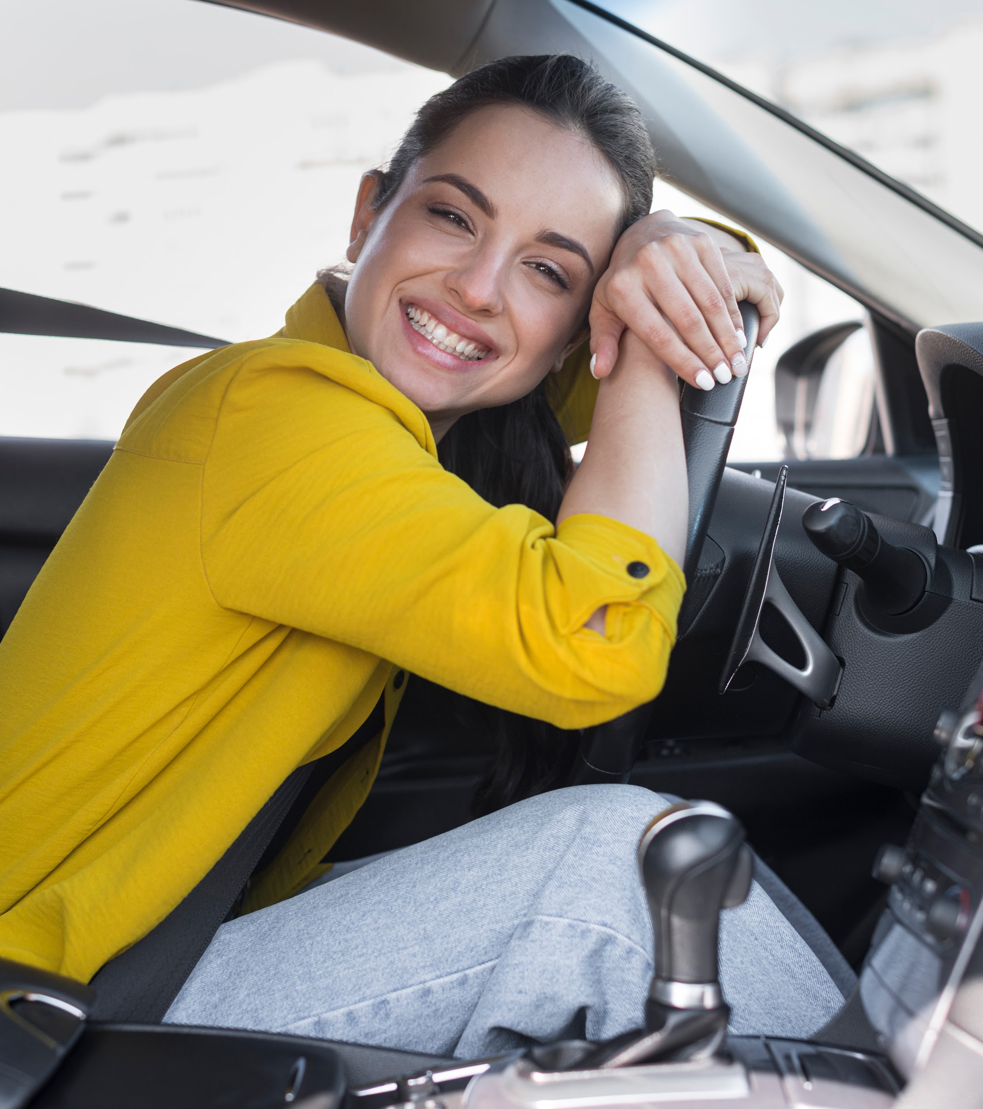
02
Methodology

Slide 7
Methodology
OpenCV
OCR
Model
It is crucial for webcam frame capture, image processing, and number plate detection, providing essential tools for efficient recognition.
IT extracts alphanumeric info from number plates, enabling text recognition, a pivotal step in accurate plate identification.
The Haar cascade model in the program aids in identifying number plates, utilizing pattern recognition for accurate detection.

Slide 8

03
Result & Discussion
HOME

Slide 9
3.1 Result
The live video stream from the webcam impressively showcases the responsiveness of our web application, providing a smooth and seamless user experience. The Haar Cascade Classifier effectively identifies license plates in real-time, with bounding boxes ensuring accurate localization. Users can seamlessly save license plate snippets through intuitive interactions, resulting in successfully stored images in the "saved_plates" directory. Key performance metrics include a robust frame rate, ensuring a high-quality video feed, and a commendable license plate detection accuracy. Overall, the system demonstrates its capability to perform real-time license plate detection reliably.

Slide 10
3.2 Discussion
The performance evaluation underscores the system's robustness while acknowledging potential challenges in handling varying lighting conditions. User interaction proves to be intuitive and effective, enabling users to effortlessly save license plate snippets. Future directions include the integration of Optical Character Recognition (OCR) for enhanced information extraction and continuous model improvement to address diverse scenarios. Scalability considerations are crucial for potential large-scale deployment. Despite current achievements, ongoing efforts are encouraged to optimize the system further and address real-world deployment challenges. The project remains open to refinements and collaborations to advance it

Slide 11
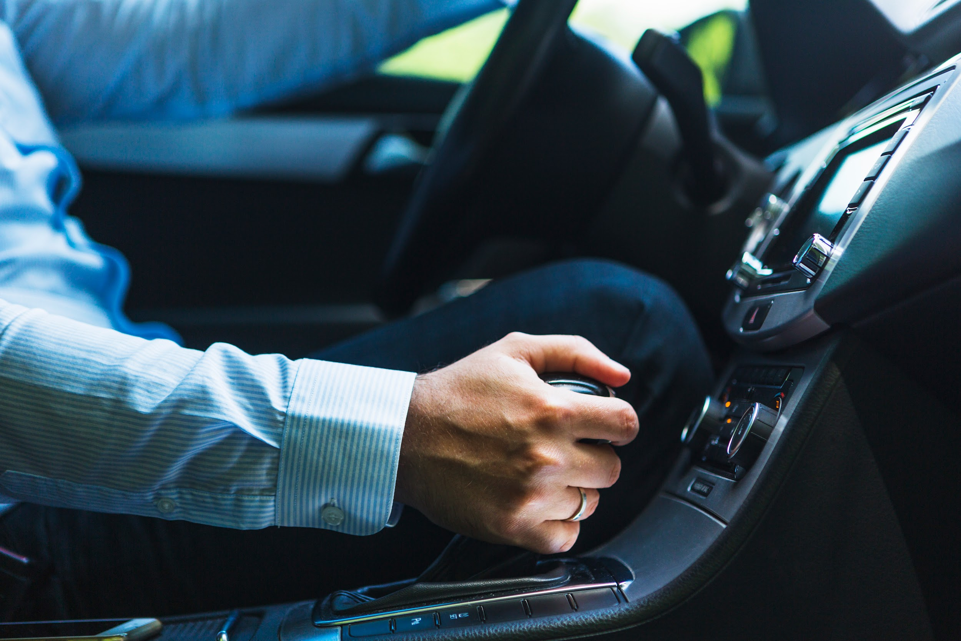
04
Conclusion & Future Work
HOME

Slide 12
4.1 Conclusion
The real-time license plate detection web application has successfully demonstrated its capabilities, providing users with a responsive and accurate platform. The integration of the Haar Cascade Classifier ensures reliable identification of license plates in diverse scenarios. User-friendly features, such as the ability to save license plate snippets, enhance the application's practicality. The project's success lies in its immediate applicability for security and surveillance purposes, offering a valuable tool for real-time monitoring. Future enhancements and collaborations are welcomed to further refine the system, address limitations, and explore opportunities for integration with emerging technologies

Slide 13
4.2 Future Work
Future work for this project involves continuous improvement and expansion of capabilities. Integration of Optical Character Recognition (OCR) can enhance the system's ability to extract textual information from license plates, providing additional valuable data. Further refining the detection model to handle challenging lighting conditions and varied angles is essential for real-world deployment. Scalability considerations for large-scale implementation should be explored, ensuring the system's effectiveness in broader contexts. Collaboration with domain experts and the community can contribute valuable insights, driving innovation and ensuring the continuous evolution of the real-time license plate detection system.

Slide 14
THANK YOU

